Slide 1
DYNAMIC
PRICING
GitHub Octernships - arimallick

Slide 2
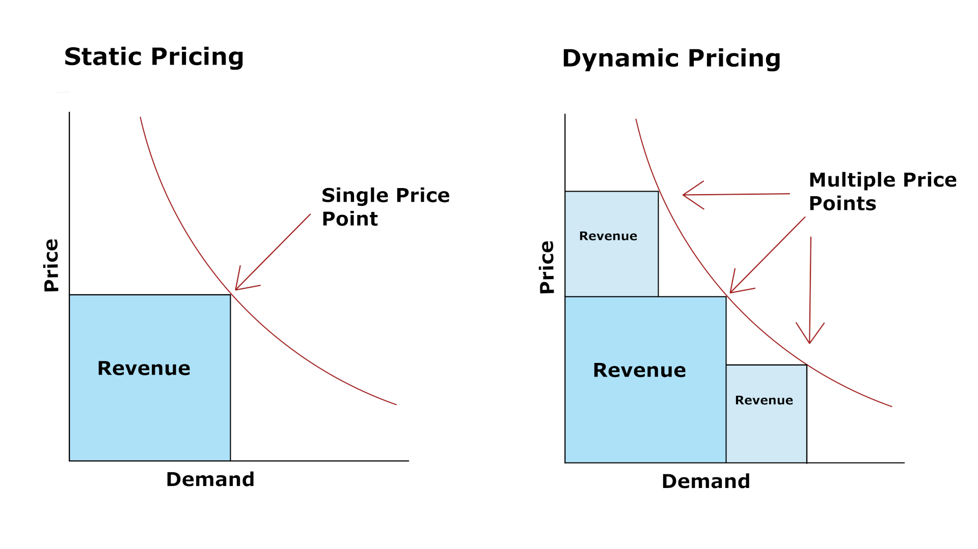
What is Dynamic Pricing?
Dynamic pricing — also known as surge pricing, demand pricing, or time-based pricing — is a strategy where businesses adjust the prices of their offerings to account for changing demand.

Slide 3
Cons of Dynamic Pricing
Customers might feel cheated and trust you less.
Inconsistent pricing might get on your customers’ nerves, frustrate them, and make them try a competitor’s product.
Overdoing may lead to loss
Overdoing dynamic pricing — specifically, excessively hiking prices during times of peak demand — could make you lose some customers and reduce your returns. Once the dust settles and your price stabilizes, you might have annoyed your base enough to miss out on their business in the future.

Slide 4
Pros of Dynamic Pricing
You can still sell in downtimes.
Sales are usually poor in times of low demand. But with dynamic pricing, you can salvage some business. How? By lowering prices to suit lower demand.
You can pay employees a higher wage during busier times.
By adjusting prices to suit heightened demand, you can raise more funds and increase wages.

Slide 5
Dynamic Pricing Using AI
Dynamic pricing algorithms work by estimating the dependency of a price on-demand in the following manner:
Processing historical sales and price data, pricing points, and current market demand (e.g., data about wrapping paper during Christmas)
Identifying significant parameters that the price depends on. For example, “school opening” is a parameter that affects stationery sales.
By generating a mathematical model based on given parameters.
Deploy the model automatically using new and updated data (whenever available)

Slide 6
AI MODELS - Reinforcement Learning (RL)
There are five key elements of reinforcement learning models:
Agent: The algorithm/function in the model that performs the requested task.
Environments: The world in which the agent carries out its actions. It uses the current states and actions of the agent as input, rewards, and the next states of the agents as output.
States: It refers to the situation of the agent in an environment. There are current and future/next states.
Actions: The moves are chosen and performed by the agent to gain rewards.
Rewards: Reward means desired behaviors that are expected from the agent. Rewards are also called feedback for the agent’s actions in a given state and are described as results, outputs, or prizes in the model.

Slide 7
Challenges of reinforcement learning:-
Reinforcement learning needs large datasets to make better benchmarks and decisions.
When the model’s complexity increases, reinforcement learning algorithms need more data to improve their decisions. That means the environments of the model may become more difficult to create a reinforcement learning model.
The results of reinforcement learning models depend on the agent’s exploration of the environment and it brings limitations to the model. The agent takes action according to the environment and its current state. If the environment changes constantly, making a good decision could be difficult.

Slide 8
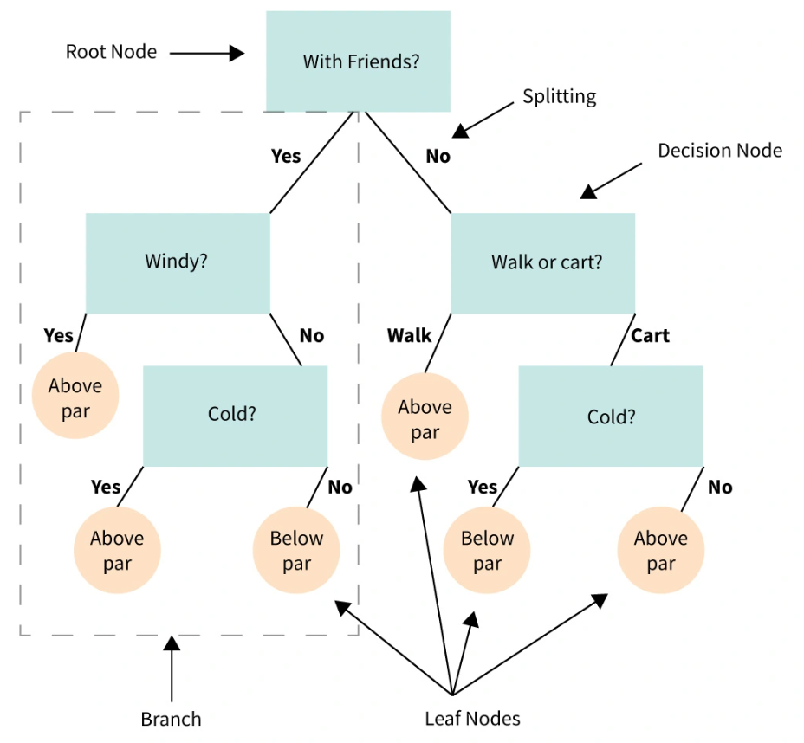
AI MODELS - Decision Tree
Decision Tree is the most powerful and popular tool for classification and prediction. A Decision tree is a flowchart-like tree structure, where each internal node denotes a test on an attribute, each branch represents an outcome of the test, and each leaf node (terminal node) holds a class label.

Slide 9
Challenges of Decision Tree Model:-
Decision trees are less appropriate for estimation tasks where the goal is to predict the value of a continuous attribute.
Decision trees are prone to errors in classification problems with many classes and a relatively small number of training examples.
Decision tree can be computationally expensive to train. The process of growing a decision tree is computationally expensive. At each node, each candidate splitting field must be sorted before its best split can be found. In some algorithms, combinations of fields are used and a search must be made for optimal combining weights. Pruning algorithms can also be expensive since many candidate sub-trees must be formed and compared.

Slide 10
How to Implement Dynamic Pricing?
1. Determine your commercial objective.
Identifying your commercial objective is the first step in implementing a successful dynamic pricing strategy. Think of your objective as a compass that directs the decision-making process of your company.
Consider the following:
Why do we exist as a company?
What are our customers’ expectations?
Do we want an increased volume of sales versus overall profit?
What is our current pricing model?
What are the perks and drawbacks of our current model?

Slide 11
How to Implement Dynamic Pricing?
2. Choose a pricing strategy.
Once you identify your commercial objective, you can find a pricing strategy that complements your goals.
For instance, if your goal is to increase the amount of product you sell, increasing prices during the holiday season may lead to decrease revenue. Static pricing may be the best fit.
However, if you’re creating a ridesharing service to help parents pick up their kids, dynamic pricing may work best. Prices can go up after the school day is over. While there may be the occasional extra-curricular activity that requires pickup, prices can go back down later in the evening

Slide 12
How to Implement Dynamic Pricing?
3. Establish your pricing rules.
While the prices of your products may change, the rules you use to set prices should stay consistent. Will prices go down if a product underperforms? What times of the day or months of the year affect your pricing? What algorithms or formulas are used to determine the percentage increase?
For instance, if an e-commerce store is going out of stock, it can set a rule to follow the lowest price range of some competitors when the stock reaches a certain number.
You’ll also have to decide which of your offerings will be affected by the switch to dynamic pricing. Will every service fluctuate, or will only a few offerings adopt this new pricing model?

Slide 13
Businesses already using Dynamic Pricing
Amazon is one of the largest e-commerce platforms with more than 300,000,000 active users as of October 2021. Amazon leverages the large amount of data collected about users’ purchase behavior and market trends to change their product prices every 10 minutes. It’s been claimed that Amazon increased its profits by ~25% by leveraging dynamic pricing strategies in 2016.
Uber is one of the largest ride-sharing service providers with more than ~93,000,000 active users around the world. Uber’s dynamic pricing algorithm adjusts the ride fares based on: time and distance of your route, traffic and peak hours, current rider-to-driver demand.
Airbnb is one of the most popular home rental marketplaces with ~150,000,000 active users who use it to book vacation stays or experiences. To determine stay prices for similar properties, Airbnb’s dynamic pricing algorithm inputs variables such as: Seasonality, Supply and demand, Day of the week, Special events and festivals, etc.
Google Ads leverages dynamic pricing for optimizing the prices of ads. The price for a Google ad changes according to what business competitors are bidding for the keywords, locations, industry, and audiences. For instance, creating an ad targeting competitive keywords or keywords with high bids will cost more than keywords with low competition. However, the potential ROI may also be higher.

Slide 14
Is dynamic pricing fair?
This question comes down to a matter of need. Using surge pricing, group targeting or demand to hike the price of a commodity is not the same as charging more for an Uber around the time that everyone needs one. In the case of goods and services such as consumer electronics, SaaS products, hotel rooms or airplane tickets the customer has a choice, we can choose to spend our hard-earned money or not. If you’re not willing to pay for the product, you’ll leave and maybe come back when there’s a sale or a cheaper version.
Theoretically, dynamic pricing should be acceptable to consumers since they ultimately have the choice to purchase a product or not, and producers must ensure that the price meets the consumers' willingness to pay. However, in reality, dynamic pricing is more complicated than pure theory. When consumers become aware of dynamic pricing, it feels like price discrimination, leading to a sense of unfairness. Consumers feel deceived and cheated when they discover that others received a better deal. This is especially true for most retail products and SaaS products, where tracking and measuring the different equilibrium prices for customer groups are challenging.

Slide 15
Links:
Reinforcement Learning: Benefits & Applications in 2023
RL R.S. Sutton
Data Science Central
Decision Tree
AI Multiple

